Slide 1
Collision detection algorithms
Computer science extended essay
Kshitij Bhatia

Slide 2
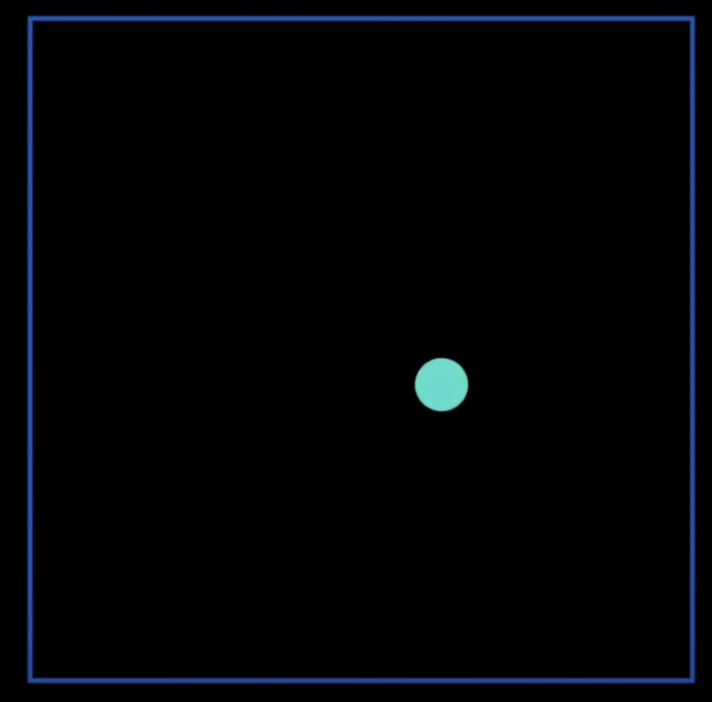
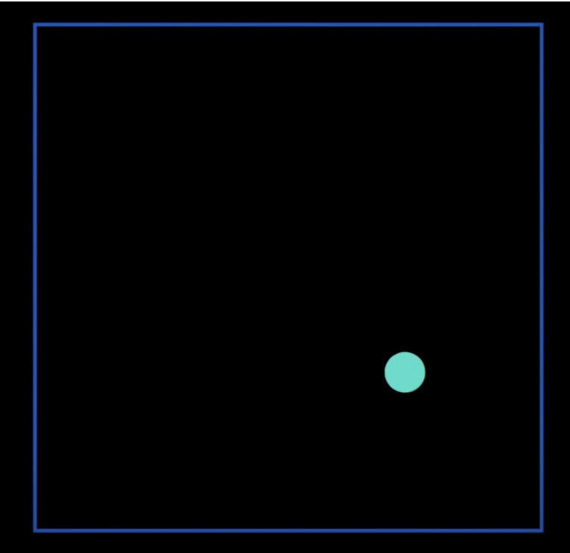
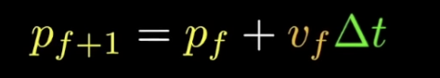
COMPUTER GRAPHICS and animation
Note: The change of position in between two frames will be very small in reality
Frame f
Frame f+1

Slide 3
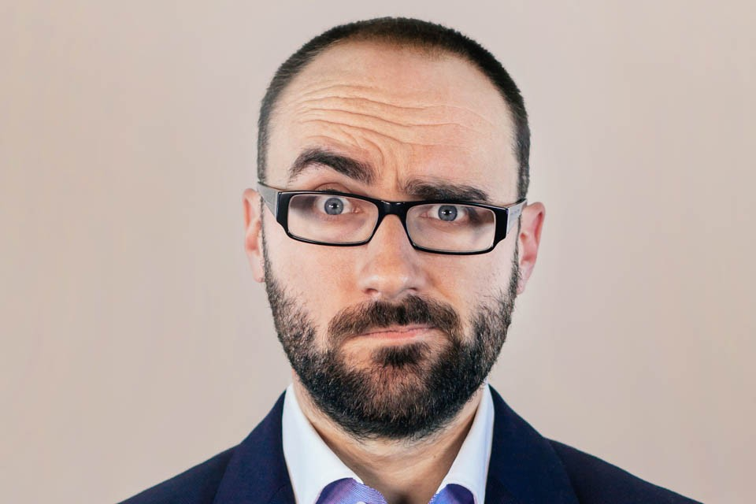

Slide 4
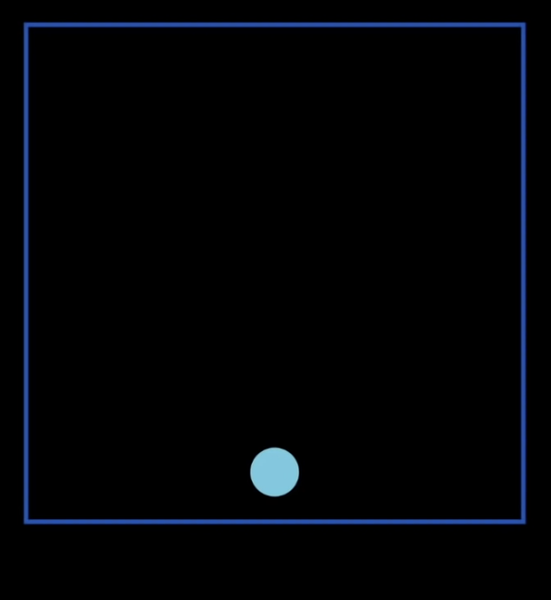
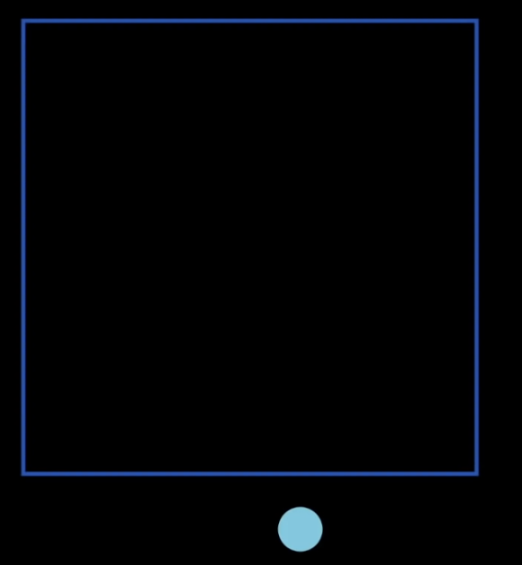
WE NEED COLLISION DETECTION
Frame f
Frame f+60

Slide 5
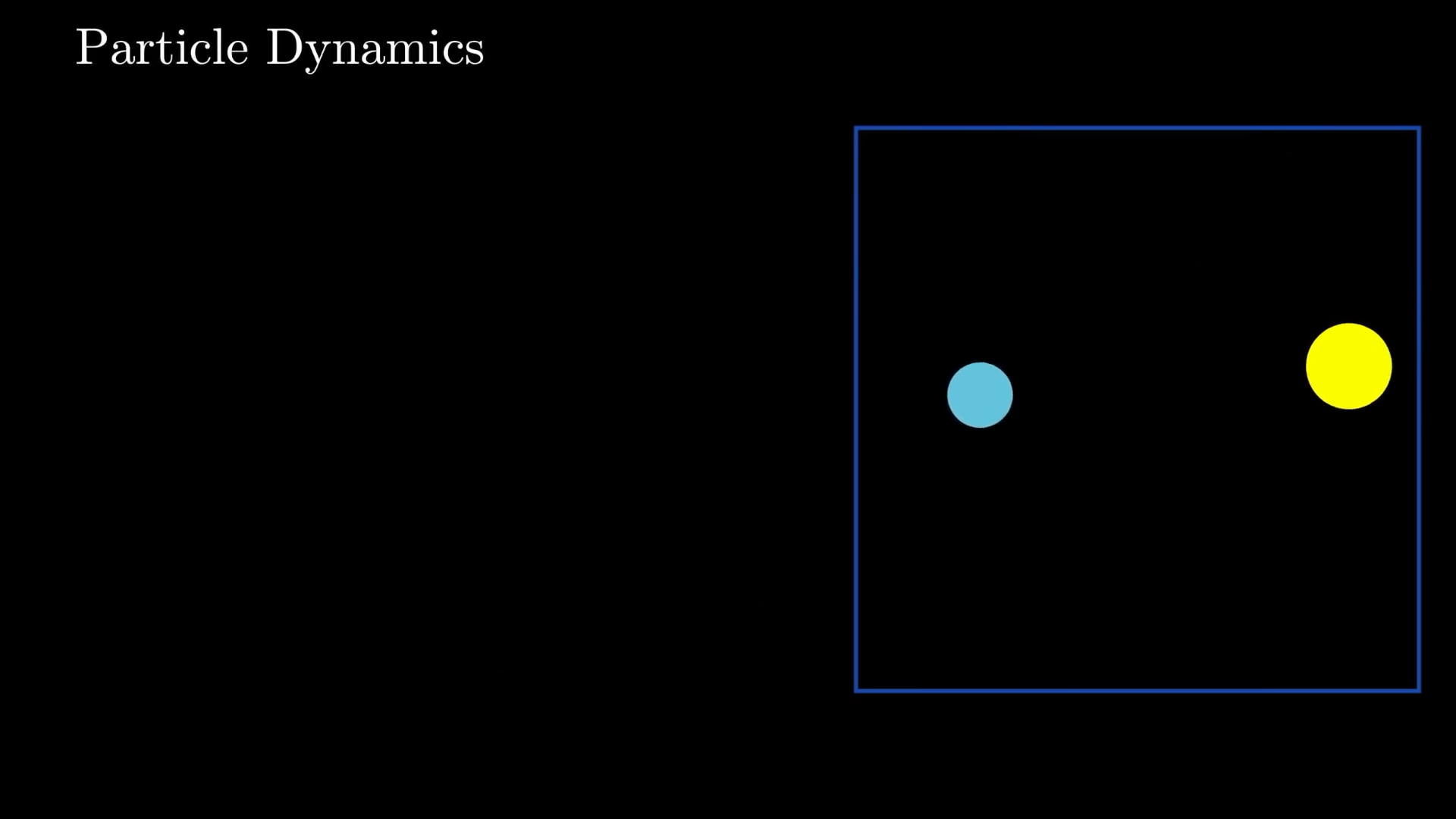
SEE IT IN ACTIOn!

Slide 6
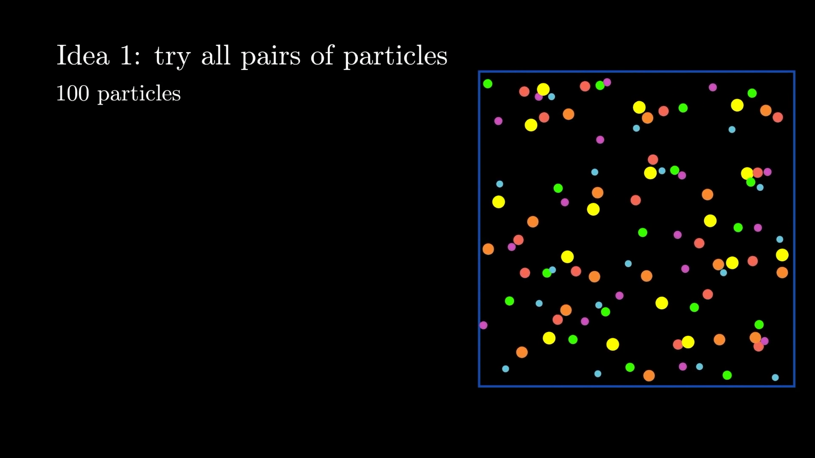
Let’s scale it up now

Slide 7
STEPS for managing collisions
Broad Phase
Filter out objects that could not have collided
Narrow Phase
Check remaining candidates manually against each other using a bounding box
Perform complex/expensive geometric checks for polygons
Collision response
Update velocities of two objects (handle the collision)

Slide 8
Research Overview and scope
Looking at various algorithms for optimizing broad phase discrete collision detection
Analyzing how time and memory usage varies based on various parameters
Comparing and evaluating the algorithms used for changes in parameters and evaluating the hypothesis
Scope
Focus on DCD (Discrete Collision Detection) and AABB (Axis Aligned Bounding Boxes)
Focus on 2 dimensional case only

Slide 9
BROAD PHASE ALGORITHMS

Slide 10

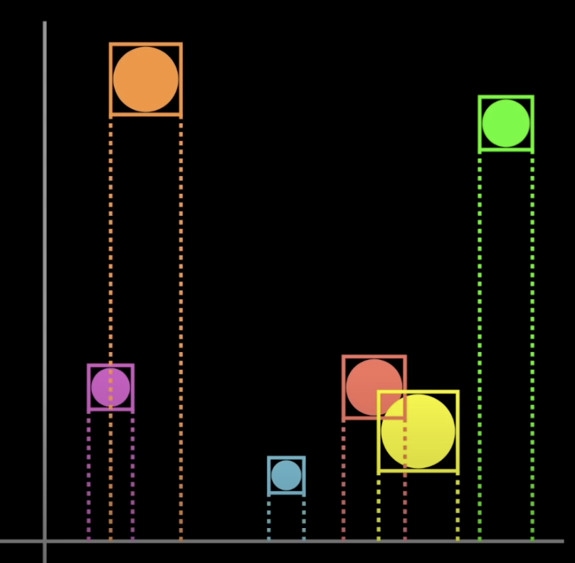
Sweep and prune

Slide 11
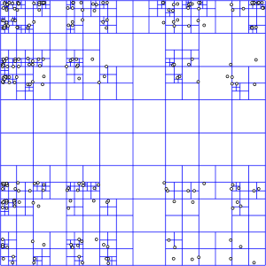
QUADTREE (non uniform partitioning)

Slide 12
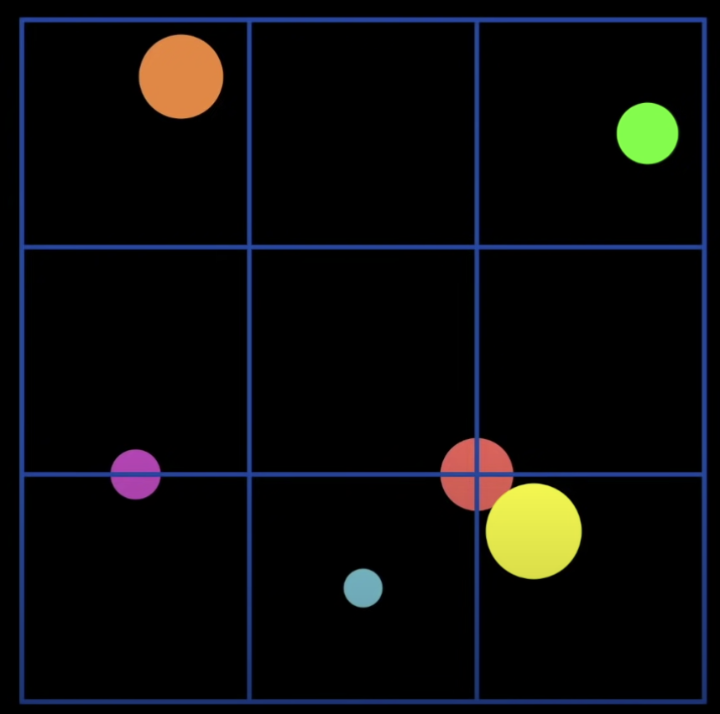
UNIFORM PARTITIONING

Slide 13
POTENTIAL PARAMeters
Generic
Number of particles
Relative size of particles
Velocity of particles
Distribution of particles (even or uneven?)
Algorithm specific
Sorting algorithm used (Sweep and Prune)
Relative grid size (Uniform space partitioning)
Maximum number of particles inside a partition (non uniform space partitioning)

Slide 14
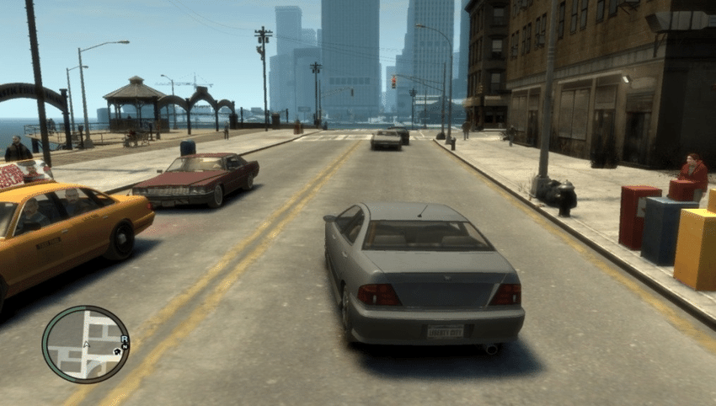
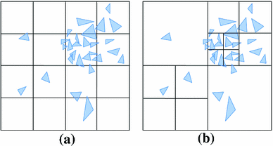
WORTHINESS
Exploring the efficiency of various algorithms as a function of various parameters help in picking the best one for the job
Sweep and prune in simulations or 2D games because of a large number of particles
Uniform grid in uniformly distributed situations such as fluid dynamics or particle simulations
Non uniform partitioning in molecular simulations or video games
Time efficiency in video games (real time rendering) vs memory efficiency in simulations

Slide 15
METHODOLOGY
Create a basic simulation in python with particles where the parameters can be varied
Use PyGame to visualize particles and simulation
Approximate the memory usage of relevant parts of the algorithm using sys.getsizeof()
Measure time difference in each frame between the relevant parts of the algorithm
Use matplotlib to dynamically plot relationship between variables
Use Scikit-learn as regression library to find a mathematical relationship

Slide 16
RESOURCES
My research will rely heavily on primary sources (by collecting the data myself and exploring the simulation myself)
Secondary Sources
Real-Time Collision Detection by Christer Ericson (for theory regarding collision detection algorithms)
Various GitHub repositories for Python implementation of these algorithm

Slide 17
Potential setbacks and what’s next
Python implementation may have weird overhead or optimizations in terms of time and space complexity and not match well with the ideal scenario (C++ or C would be more ideal)
Data set may be too small to match theoretically predicted asymptotic behavior
Too many parameters currently – research is not focused
Set up a simulation
Need to narrow down parameters and look at only significant ones
Decide which version of algorithms to use

Slide 18
